Slide 1
In this lecture, I will explain you numpy ones function (np.ones) and will show you how to create an array filled with ones in numpy.

Slide 2
Let’s take a look at the syntax.
There are three parameters that specify the structure of the resulting array.
1. shape
2. dtype
3. order
But order parameter is used less, so we’re not going to cover it in this lecture.

Slide 3
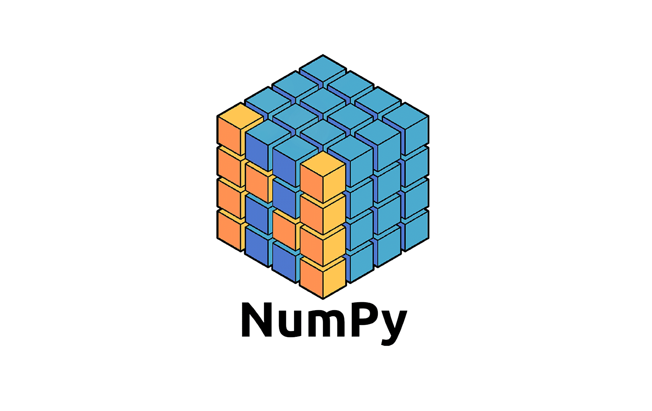
Numpy
Part 16
Arvind Kharwal
www.Kharwal.com

Slide 4
Numpy Operations

Slide 5
Ones Function

Slide 6
The numpy ones() function is used to create a new array of given shape and type, with ones.

Slide 7
Syntax:
numpy.ones(shape, dtype, order)

Slide 8
Shape: Required
The shape parameter specifies the “shape” of the array that you want to create.

Slide 9
The argument to shape will be an integer, or a tuple of integers or a list of integers.
If you only provide an integer n, then output will be a numpy one dimensional array with n ones.
But if you provide a tuple or list of values, [n, m], ones() function will create an array of ones with n rows and m columns.

Slide 10
dtype: This parameter specify the data type of the data in the new array.
Optional.
float64 as the default data type.

Slide 15
Thank You

